Slide 1
New Forms of Privatization Making It Public: Evidence and Action Against Privatization National Union of Public and General Employees Ottawa, Canada 28-30 October 2014
Dexter Whitfield
Director, European Services Strategy Unit, Adjunct Associate Professor, Australian Workplace Innovation and Social Research Centre, University of Adelaide

Slide 2
Agenda
Current context
Why new forms of privatisation have emerged
New forms of privatization
Economics of the new privatization
The vested interests promoting these new forms
Examples of new forms of privatization
Performance of new forms of privatization
Effect of a 'public service economy'
Impacts for service users and public employees
Lessons learnt and action strategies

Slide 3
Context
Continuing austerity combined with neoliberal objectives: Free trade and competition Deregulate to accumulate Deconstruct democracy – consolidate corporate welfare Reconfigure the state and cut taxes Reduce cost and power of labour
UK led the way in neoliberal transformation - financialization, personalization, marketization and privatization.
Austerity-driven continuation of existing forms of privatization to wider range of assets and services.
Increasing political consensus between main political parties.
Taxation, corporate evasion and public resources.
Free Trade Agreement negotiations – TTIP, CETA, TISA.
Debate about the ‘social economy’.

Slide 4
Why new forms of privatization have emerged internationally and in Canada
Mutation of privatization required to extend it
Changes in the role of the state
Demands of capital for new opportunities for accumulation
Changes in the finance of services
Changes in employment
Changes in the distribution of power
But high risks, failures, threats and vulnerabilities

Slide 5
Outline of the new forms
P3 strategic partnerships.
Whole service contracts.
Social impact bonds – payment by results – and privately financed social investment projects.
Transfer of public services.
Expanded role for non-profit organizations.
Fragmentation of public networks eg schools and hospitals into stand alone semi-commercialized organizations.
Personal Budgets extended to more health and social care service users.
Community rights to challenge, bid, buy, manage, build, buy and transfer assets to non-profit organisations or private companies.
Monetizing & recycling public assets & P3 secondary market.

Slide 6
Six parts to each pathway

Slide 7
Economics of the new privatization

Slide 8
The vested interests promoting the new forms
Role of philanthrocapitalism
Foundations and charities Social finance intermediaries
Large non-profit housing groups
Social enterprises
Growth shadow banking - hedge funds, private equity
Transnational companies and corporate social responsibility
Trade and business organizations
Right wing think tanks and political groups

Slide 9
Neoliberal public management
Commissioning – separation of purchaser and provider functions.
Loss of experience in frontline service delivery and contact with service users.
Public sector relinquishes responsibility for changes in staffing levels, terms and conditions, and the employment practices of contractors.
In-house option restricted to ‘business as usual’.
Rationalisation as services are privatized.

Slide 10
P3 Strategic Partnerships
Long-term, multi-service, multi-$m contract.
50 – 1,000 staff transfer to contractor or Joint Venture Company.
Contracts 10 -12 years with 5 year extension option, highways and waste contracts 25+ years.
Focus on services and revenue budgets.
Minimal private finance because small infrastructure element.
Big savings and job generation targets but…….
‘World class services’ & ‘beyond excellence’ claims.
Highways are ‘whole service’ contracts.

Slide 11
P3 strategic partnerships

Slide 12
Impact investing - social investment
New market for financial intermediaries, contractors, consultants & lawyers.
Promoted by JP Morgan, Goldman Sachs, Bank of America.
“..allows government to purchase results” (G8 Taskforce)
Enforces neoliberal role of government – public sector as facilitator with loss of accountability.
Market redefining impact assessment.
No reference to quality of jobs and trade union organization – charities, social enterprises.
Secondary market in SIBs – the Social Stock Exchange!

Slide 13
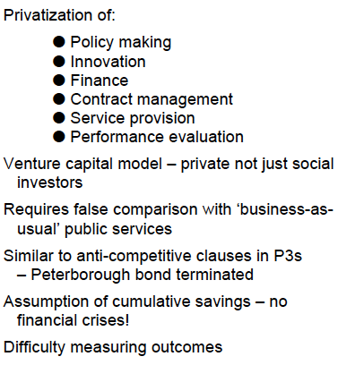
Social Impact Bonds

Slide 14
Social Impact Bonds – savings?

Slide 16
Transfer of services to social enterprises
Initially Housing Management Companies, Leisure and Care Trusts.
Now
Local Authority Trading Companies
Social Enterprises - some believe this is not privatization
Local Enterprise Partnerships for economic development, transport and housing investment
Over C$400m UK government grants to establish social enterprises in health & local government.
Motives and potentially ‘poisoned chalices’?

Slide 17
Personal budgets
Personalisation agenda and ‘co-production’.
Initially to give people requiring long-term complex needs with more control over services.
Extended entitlement to more and more groups in social care, health and special educational needs.
A direct payment to purchase services (24% social care)
An account held and managed by local government
An account held by a third party and called off by users
Integrated health and social care personal budgets April 2015
Effect of budget cuts.
Service users select a service provider – increased role for voluntary & community services – ‘virtual market places’
Legal constraints imposed on use in in-house services.
Variant to education vouchers.

Slide 18
Future of P3 projects
Citywide contracts combining infrastructure & services
Growth of secondary market trading public assets and offshore tax evasion – Canada - UK reform for public sector equity stakes!
Exclusion of support services but also growth of hospital hotel services contracts.
Buy-back proposals – who pays and need for end of P3s.
Increased monetizing/recycling of public assets.
Created Corporate Welfare system – P3 Wealth Machine.
Need for new integrated direct public investment model, alliances and action strategies.

Slide 19
Performance of new privatizations
Local Authority Trading Companies – several closures/wage cuts
Employee-owned bus companies – gone
Management buyouts – gone
Mutual building societies – many demutualized
Largest leisure trust operates as a private contractor
Growth of national chains housing associations diversified into social care and private housing

Slide 20
Effect of a 'public service economy'
New and higher charges for public services – monetizing of public sector.
Job losses and cuts in terms and conditions
Weakened trade union organisation
Erosion of democratic accountability and transparency
‘Commercial confidentiality’ to stop involvement
Equalities and social justice marginalised
Increased competition for resources
Reduced capacity of government to tackle poverty, inequalities and basic needs.

Slide 21
Impacts for service users
Market forces will determine the quality of services.
Contracts lead to a loss of flexibility and responsiveness.
Getting answers will be more tortuous.
Services increasingly treated as individual ‘customers’
‘Commercial confidentiality’ will limit disclosure.
The blame game will get worse as contractors shift responsibility for delays and failures
Contractual disputes could cause delays.
Community involvement restricted due to procurement.
Increased user fees, charges and tolls.

Slide 22
Impacts for public employees
Redundancies, loss of job security and transfers as contracts are won or lost.
Replacement of staff on lower grades.
Wage and benefit cuts.
Threat to pensions - closure of defined benefit pensions
Reduced implementation of equality policies.
New working practices.
Increased use of volunteers.
Operate in a contract culture with commercial values
Fragmented trade union organisation

Slide 23
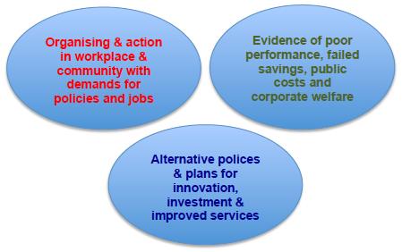
Lessons learned
New forms of privatization driven by neoliberal ideology & austerity
3 key strategies:

Slide 24
Action strategies

Slide 25
Sources
PPP Wealth Machine: UK and Global Trends in Trading Project Ownership
http://www.european-services-strategy.org.uk/ppp-database/ppp-equity-database/ppp-equity-report-final-full.pdf
PPP Strategic Partnerships Database 2012-2013
http://www.european-services-strategy.org.uk/ppp-database/ppp-partnership-database/ppp-strategic-partnerships-database-2012-2013.pdf
The Mutation of Privatization: A critical assessment of new community and individual rights http://www.european-services-strategy.org.uk/publications/essu-research-reports/the-mutation-of-privatisation-a-critical-asses/mutation-of-privatisation.pdf
Costs and Consequences of a One Barnet Commissioning Council
http://www.european-services-strategy.org.uk/publications/public-bodies/transformation-and-public-service-reform/transformation-strategies/costs-and-consequences-of-commissioning-counci/costs-and-consequences-of-commissioning-council.pdf
NCIA Inquiry into the Future of Voluntary Services: The Ideological Context, Working Paper 4 http://www.independentaction.net/wp-content/uploads/2011/03/Ideological-Context-final.pdf
Unmasking Austerity: Opposition and Alternatives in Europe and North America (2014), Spokesman Books, Nottingham.
Global Auction of Public Assets: Public sector alternatives to the infrastructure market and Public Private Partnerships (2010), Spokesman Books, Nottingham.
In Place of Austerity: Reconstruction of the state, economy and public services (2012), Spokesman Books, Nottingham.

